Slide 1
Process
Filter is applied to the sensor data
SVD is applied to the sensor data (in the time domain)
Extract a segment of e.g. 512 samples across each of the 8 sensors
Perform a SVD matrix factorization
Plot Singular Values
In this case, only the SVD singular values are of interest, so there are no waterfall plots for the filters

Slide 2
BP Filter Parameters
Waterfall Plots
Constants
BW: 1/10
Decimation: 9
F_{ord}: 80
F_{ctr} moves through the range 0, 1/10, 2/10, 3/10, 4/10, 5/10, 6/10, 7/10, 8/10, 9/10
Waterfall plot of Snippet 14
No SVD removal
No modification
The black box is where SOI is located
Added because SOI is difficult to see

Slide 3
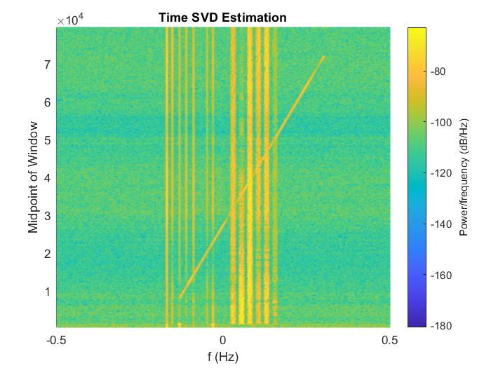
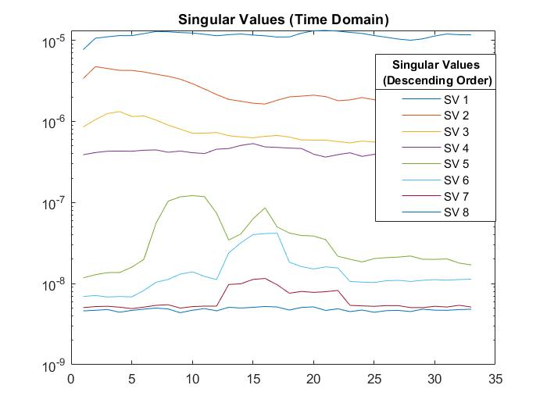
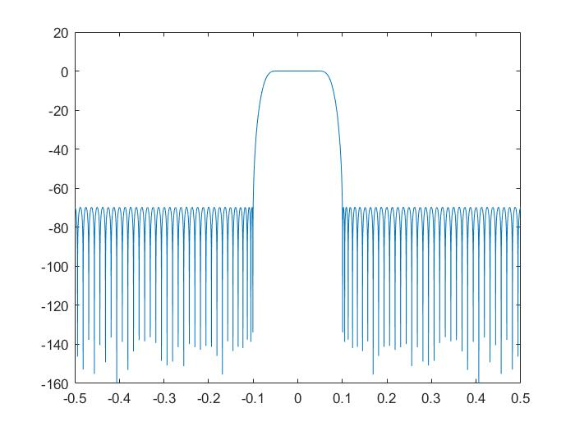
Filter 1
SOI

Slide 4
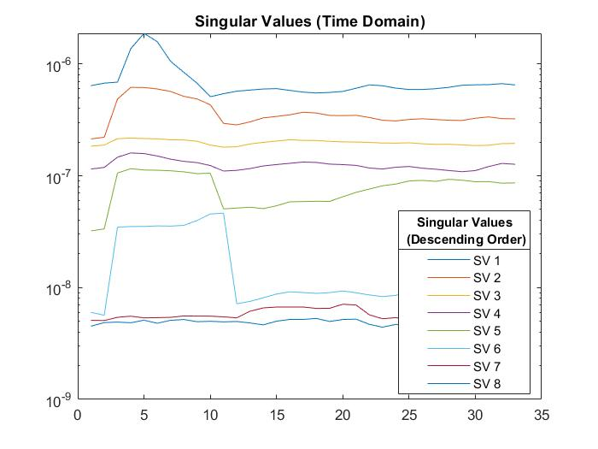
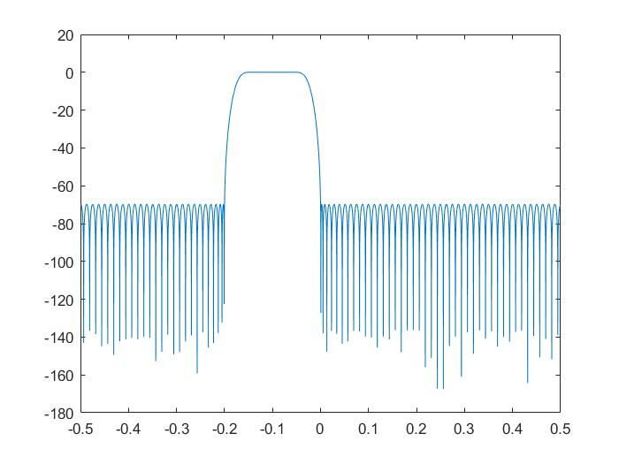
Filter 2

Slide 5
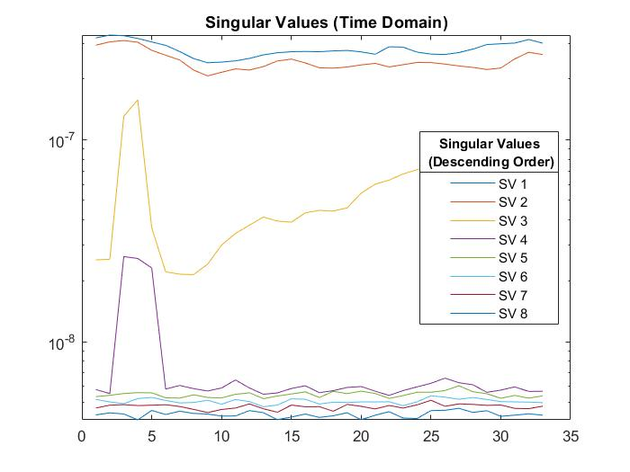
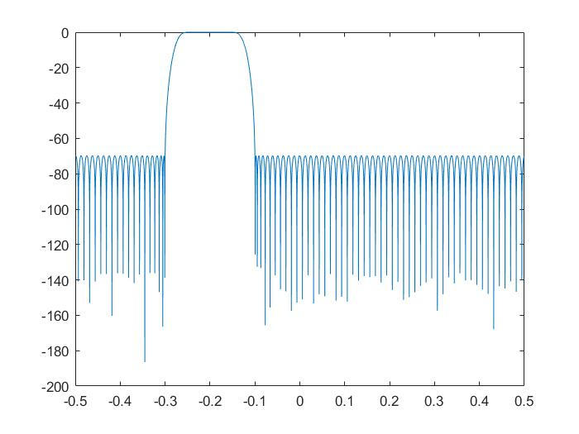
Filter 3

Slide 6
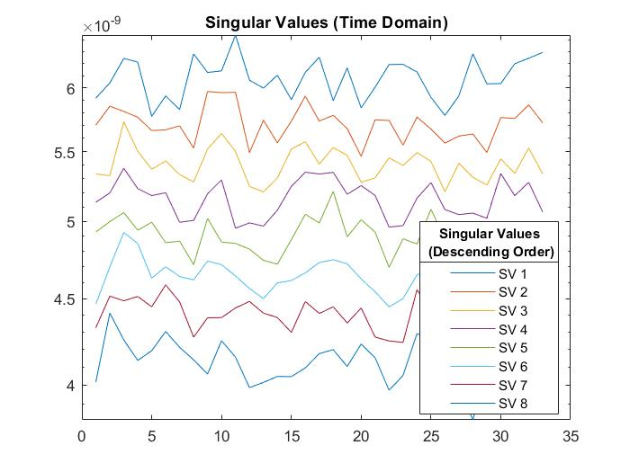
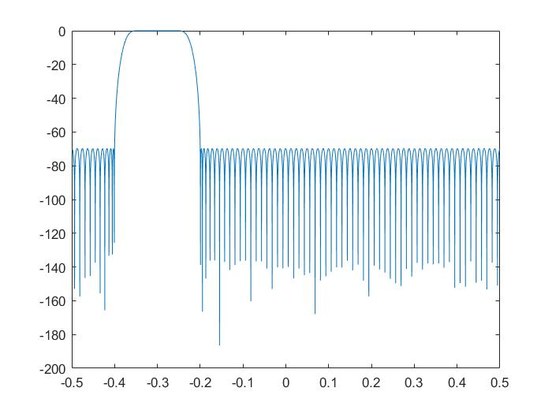
Filter 4

Slide 7
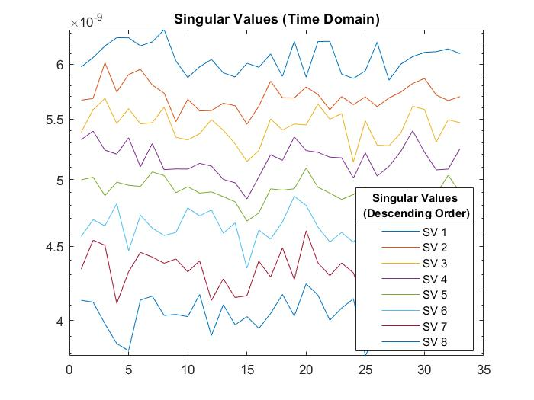
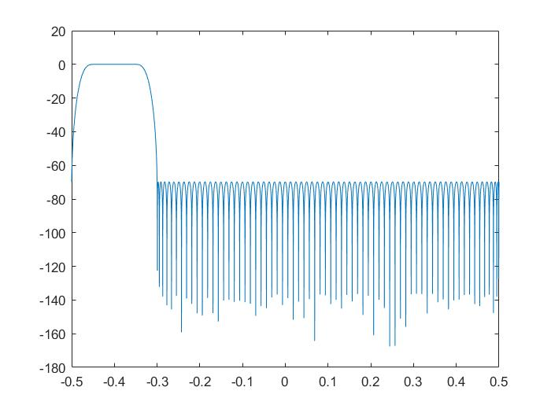
Filter 5

Slide 8
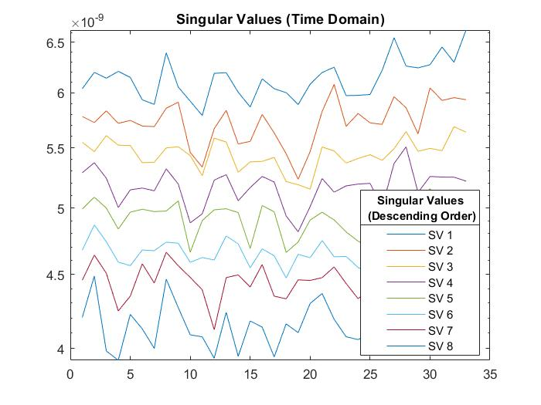
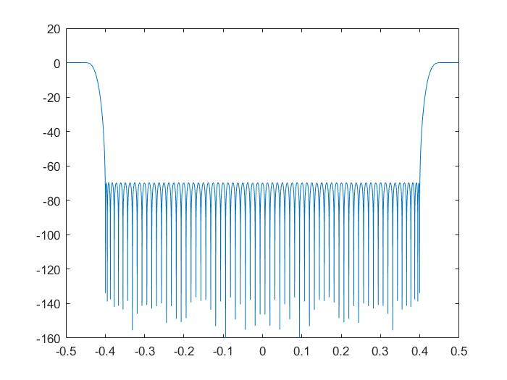
Filter 6

Slide 9
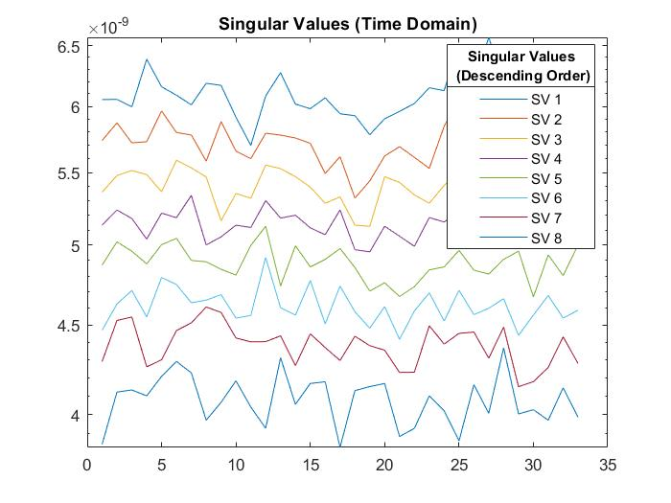
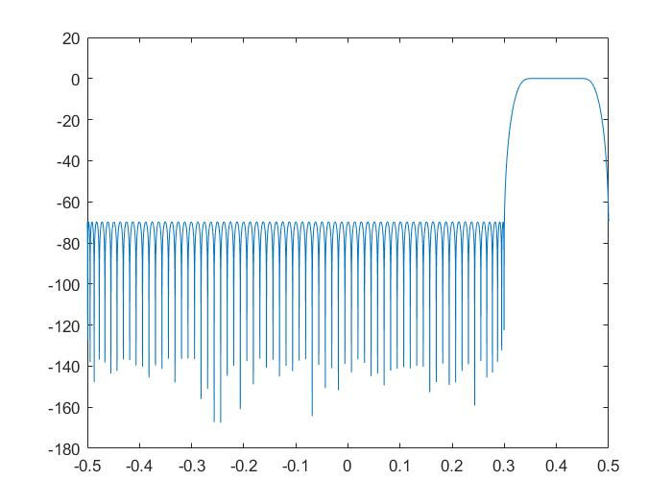
Filter 7

Slide 10
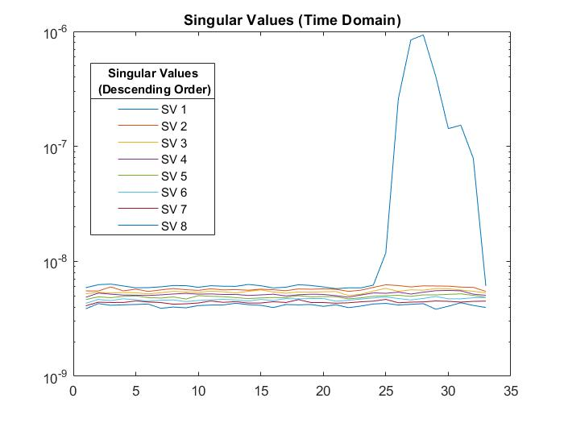
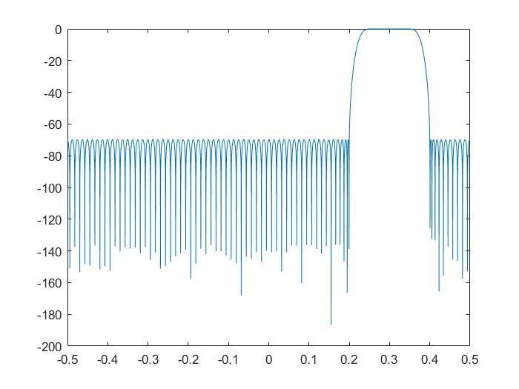
Filter 8

Slide 11
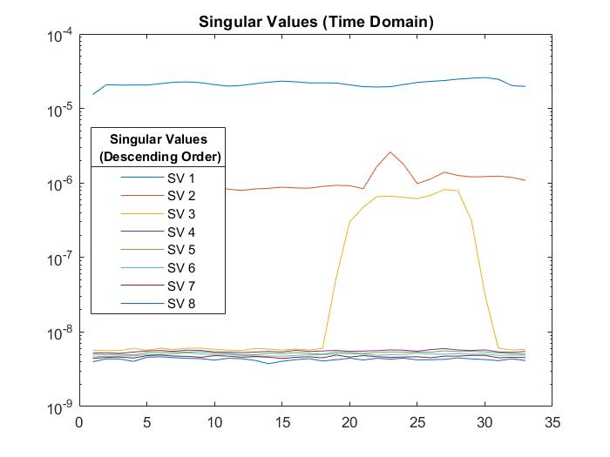
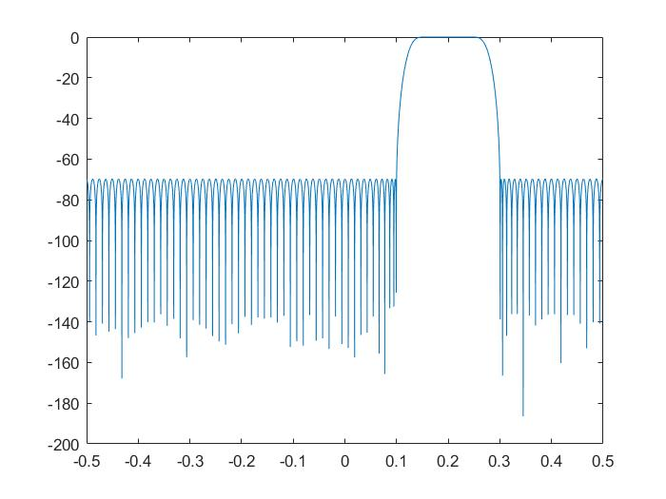
Filter 9
Nuisance or SOI?

Slide 12
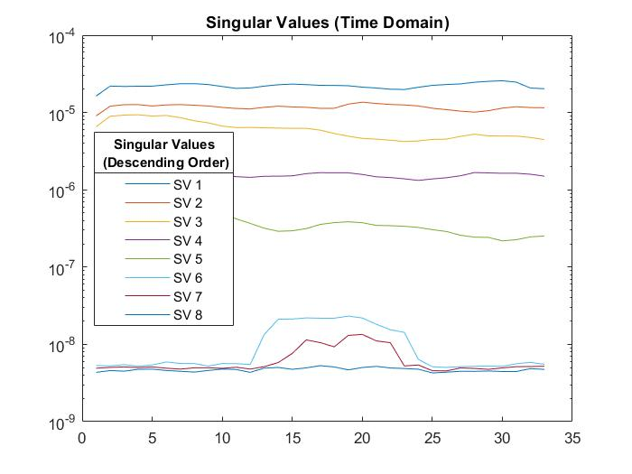
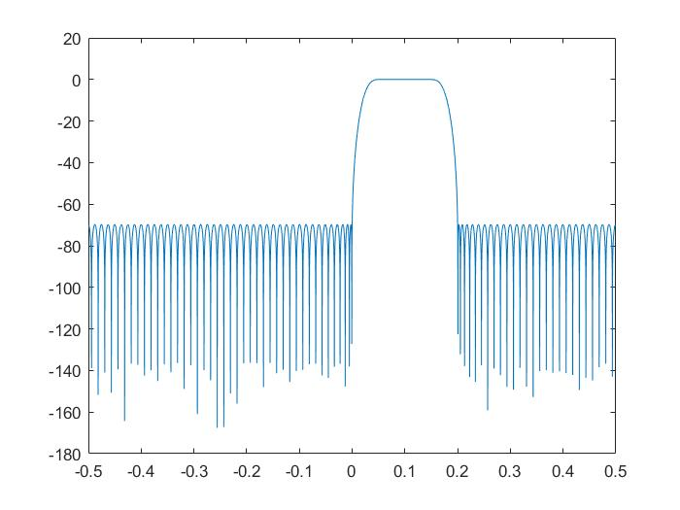
Filter 10
Nuisance Signals
SOI

Slide 13
Summary
Results
SOI can be seen in the SVD of Filters 1 and 10
Filters 1, 2, 3, 9, and 10 show the singular values of the narrow band nuisance signals
Filter 8-9 show the SVD of the diagonal signal and another nuisance signal
Filters 4-7 is just random noise
The results line up with what is expected when looking at the waterfall plots and filter frequency response

